Slide 1
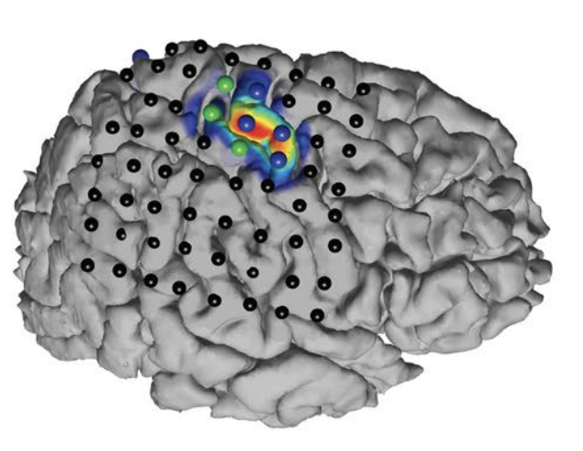
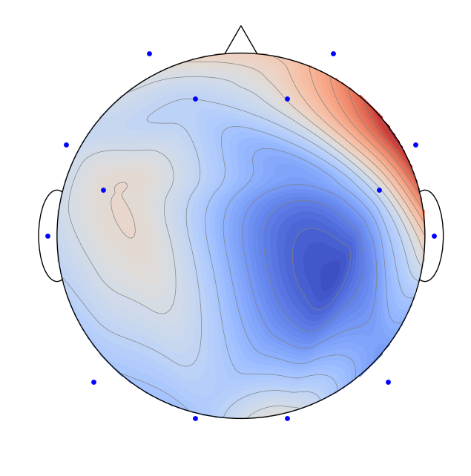
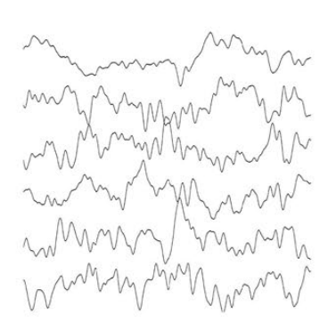

Spatial Filtering for Source Separation in EEG Data
Christian Endl, Felix Wirth, Korbinian Kunst & Taulant Koka

Slide 2
Agenda
1. Understanding the Basis of Source Separation via an Intuitive Example-Driven
Approach
2. Discussion of Experiment Design
3. Graph Blind Source Separation
4. Graph Blind Source Separation results
Summary of major outcomes
Problems and future research

Slide 3
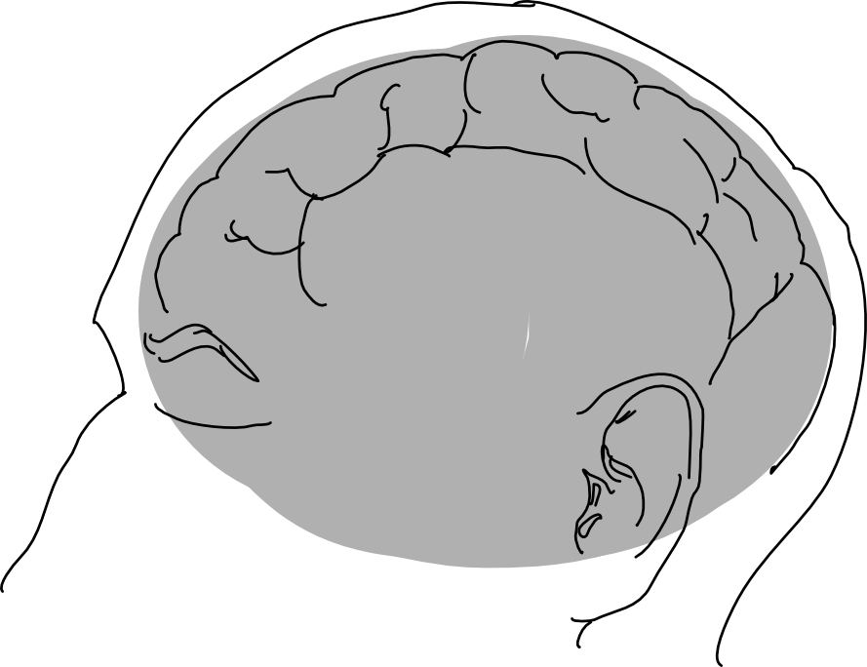
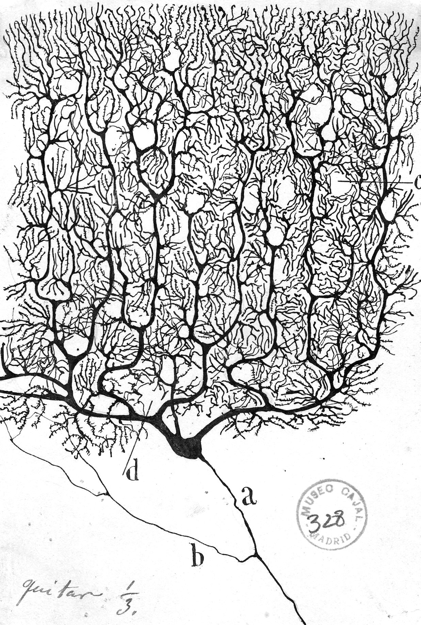
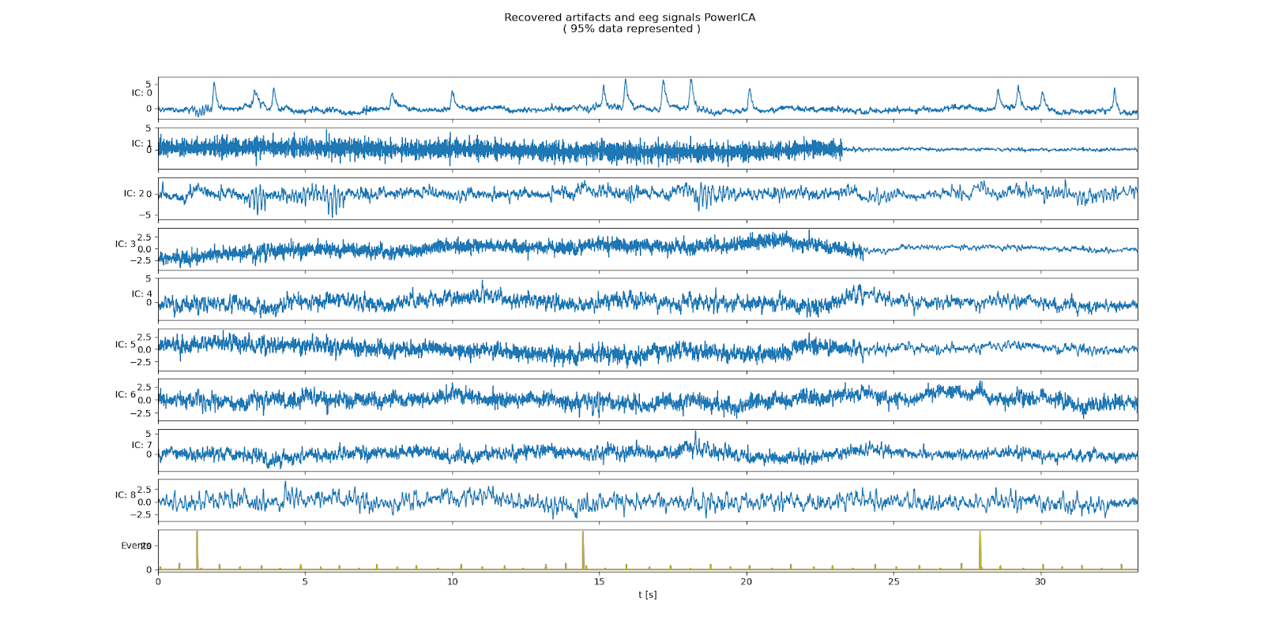
Motivation Challenge of Working with EEG Data
Electroencephalogram (EEG) Concept
What we wish to have?
We are observing the "oscillating slow fields" of neurons in the upper layers of the cerebral cortex.
These changes in electrical potential lead a neuron to be more likely or less likely to fire action potentials and are important in encoding information in the brain.
What do we get in experiments?
“
Working with EEG data is
therefore the process of source separation
EEG Channels
time t in seconds

Slide 4

Spatial Filtering for Source Separation Cocktail Party Problem
Def. I: In contrast to temporal filtering in DSP where a signal is analyzed as time-(in)variant subsequent discrete values of one channel, spatial filtering looks at the relation of a given timepoint across multiple channels.
Def. II: The topic of separating mixed sources is called Blind Source Separation (BSS) and can be solved by algorithms called Independent Component Analysis (ICA).
Notes:
Sosund is particular good example because sound add linearly

Slide 5

The Concept of Source Seperation Cocktail Party Problem

Slide 6




The Concept of Source Seperation Cocktail Party Problem

Slide 7
The Concept of Source Separation Cocktail Party Problem
Original Signals
Sensors
Reconstructed Signals
Latent Variables
Observed Data
Result of the ICA

Slide 8

The Concept of Source Separation Cocktail Party Problem
Original Signals
Overlay of Signals
Sensors
Latent Variables
Mixing Matrix
Observed Data
$$s W x$$

Slide 9
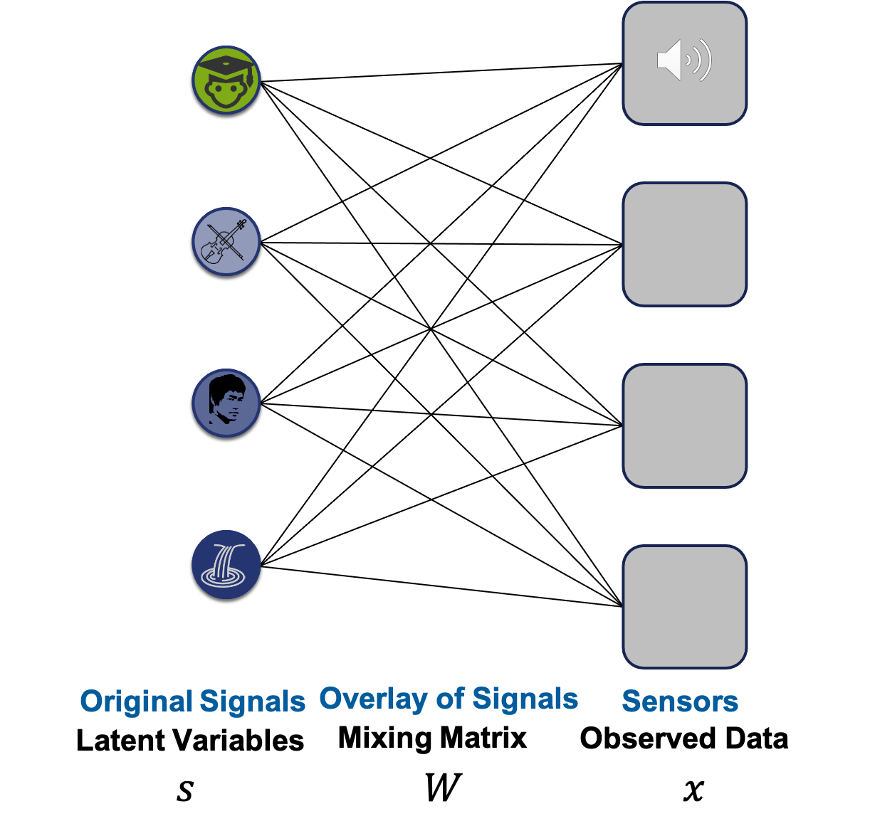

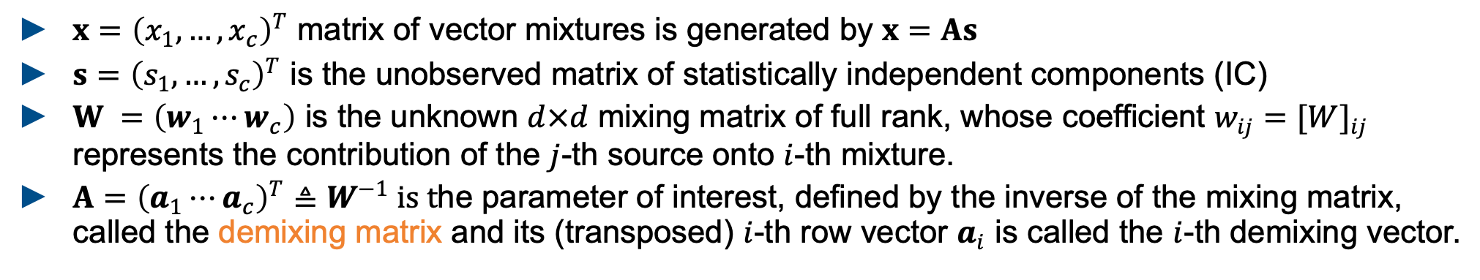

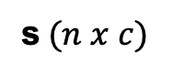
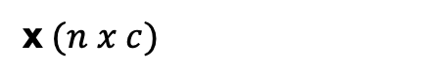
The Concept of Source Separation Math Formulation for ICA (Independent Component Analysis)
$$s W=x$$
s$(n x c)$
W$(c x c)$
x$(n x c)$
$x={\left(x_{1},…,x_{c}\right)}^{T}$ matrix of vector mixtures is generated by $x=As$
$s={\left(s_{1},…,s_{c}\right)}^{T}$ is the unobserved matrix of statistically independent components (IC)
$W =\left(w_{1}⋯w_{c}\right)$ is the unknown $d×d$ mixing matrix of full rank, whose coefficient $w_{ij}=[W]_{ij}$ represents the contribution of the $j$-th source onto $i$-th mixture.
$A={\left(a_{1}⋯a_{c}\right)}^{T}≜W^{−1} is t$he parameter of interest, defined by the inverse of the mixing matrix, called the demixing matrix and its (transposed) $i$-th row vector $a_{i}$ is called the $i$-th demixing vector.

Slide 10
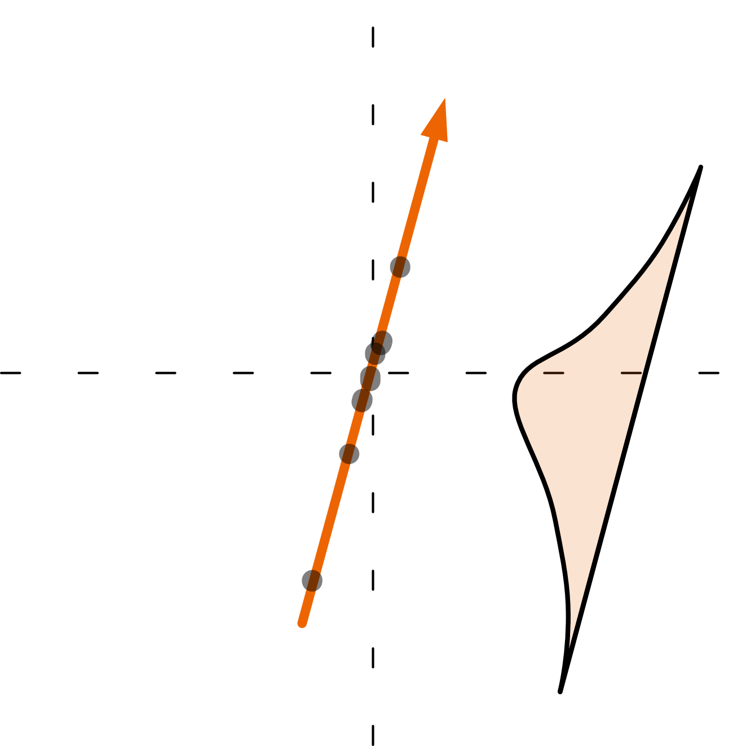
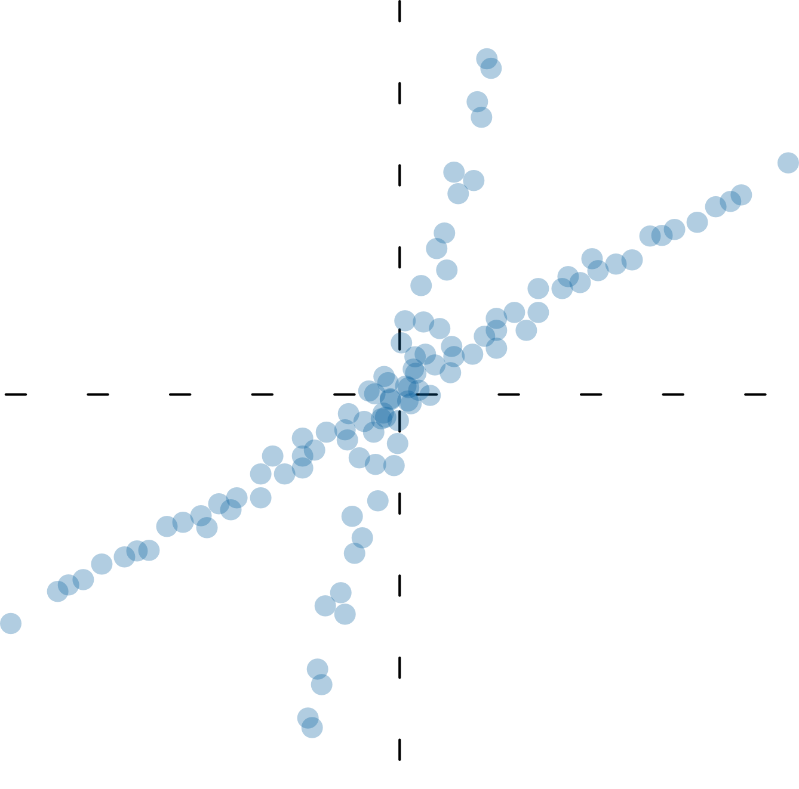
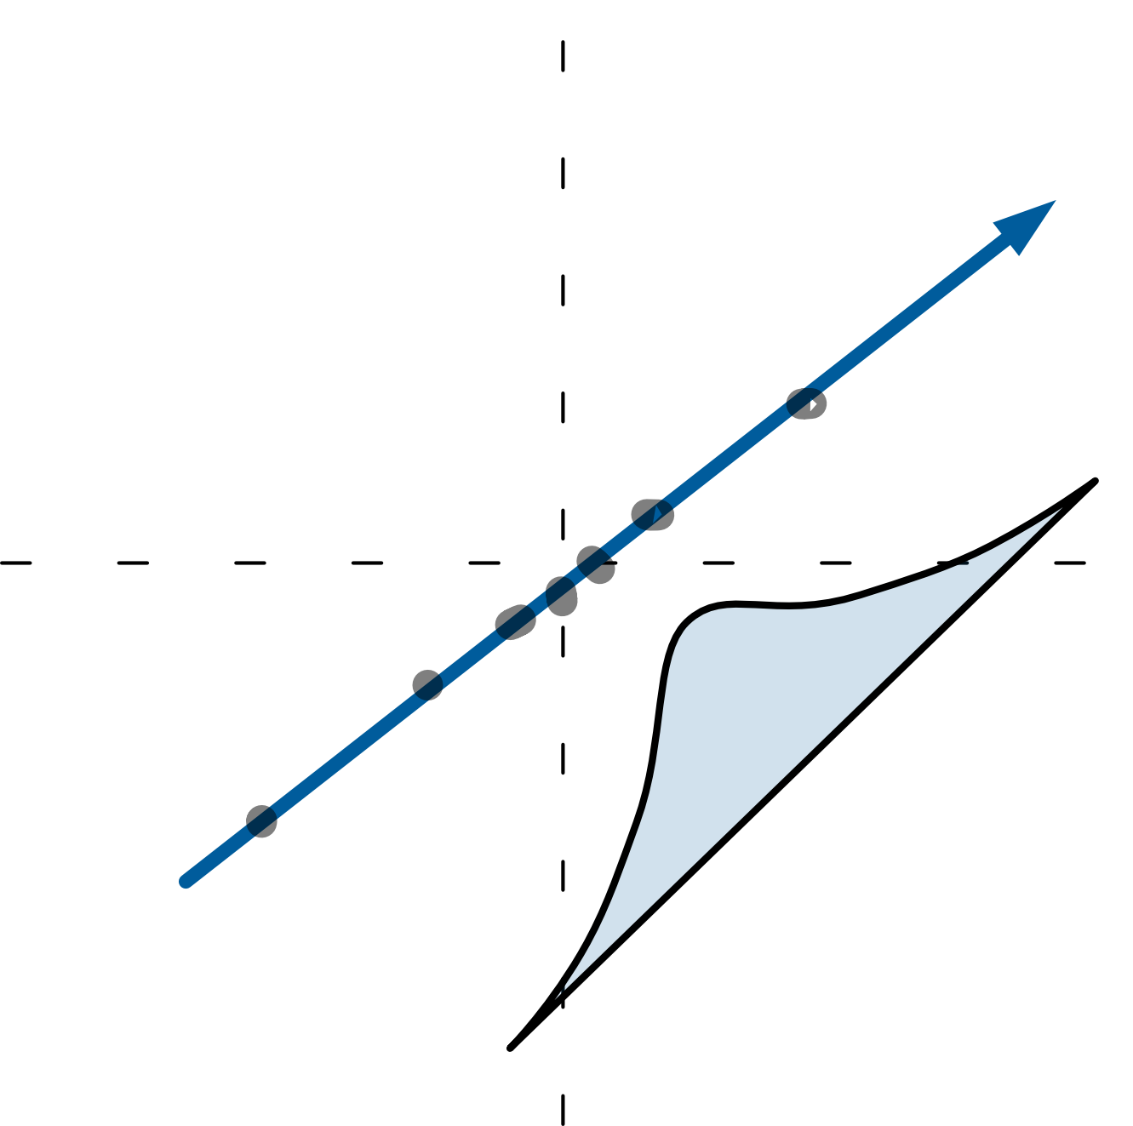
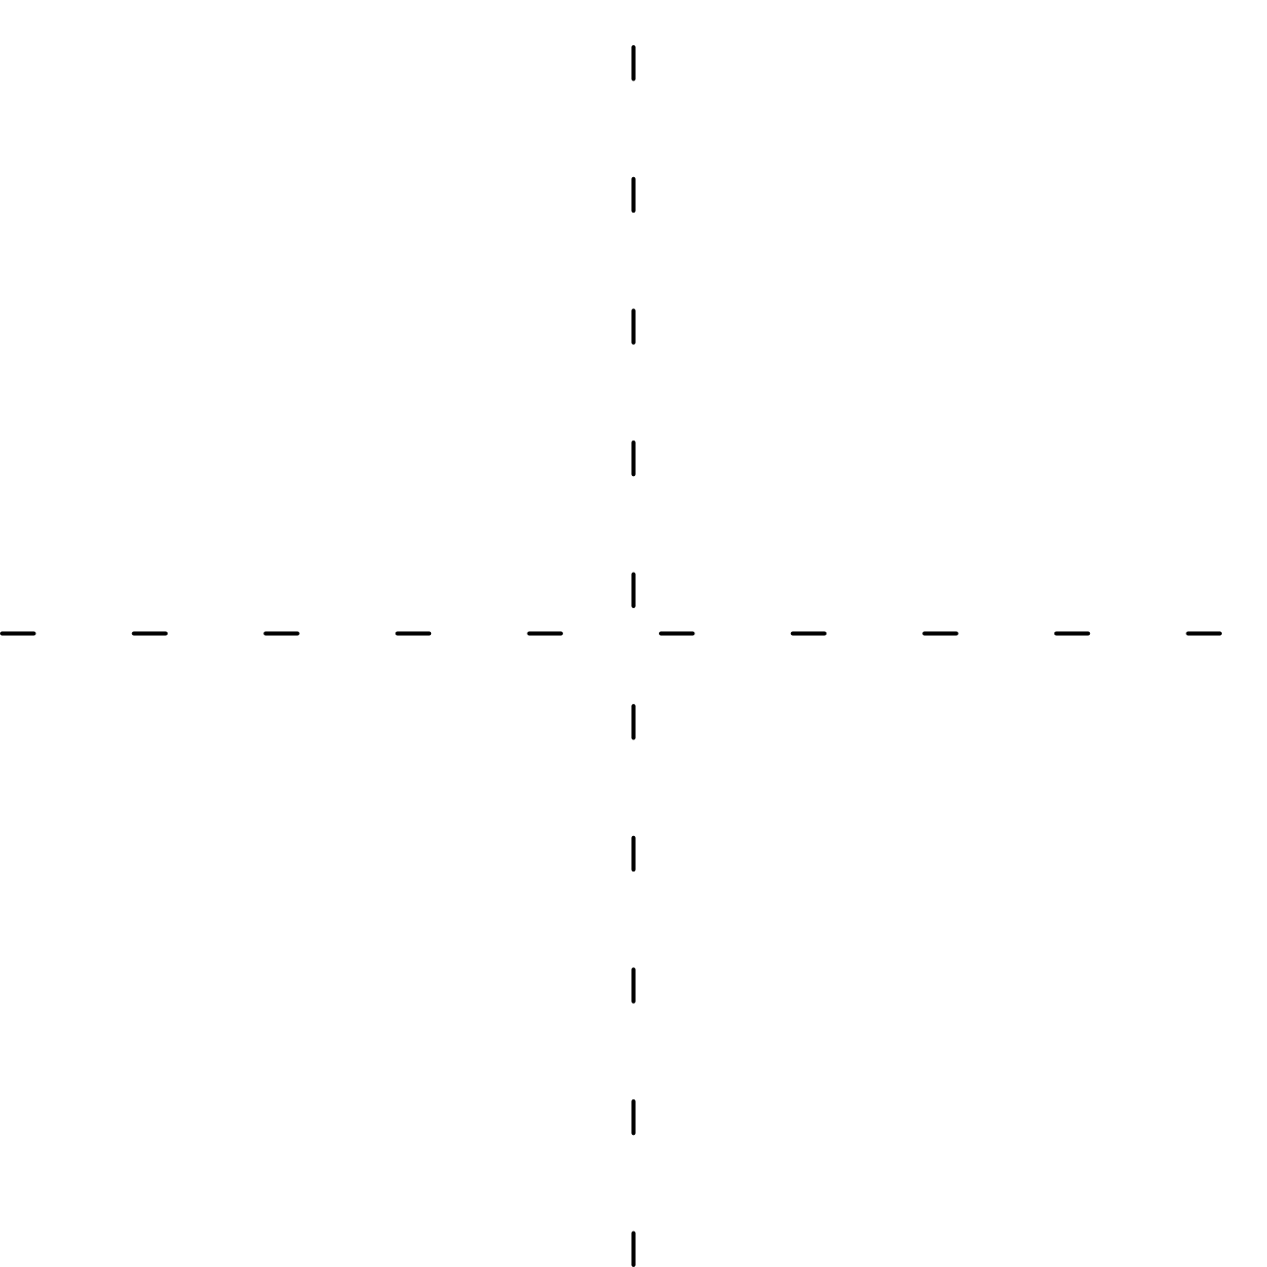

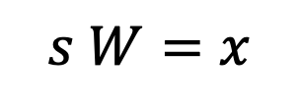
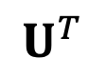

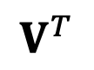
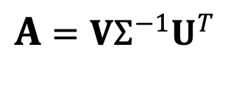
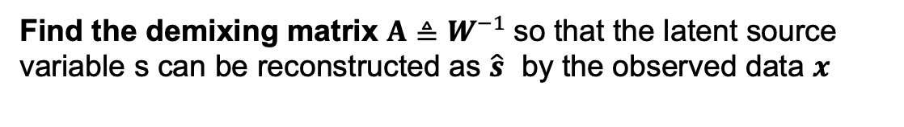
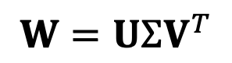


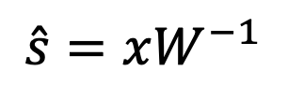

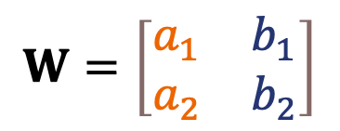
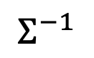
Independent Component Analysis Solving blind source seperation using ICA
What is the goal of the algorithm?
$$s W=x$$
$$\hat{s}=xW^{−1}$$
Find the demixing matrix $A≜W^{−1}$so that the latent source variable s can be reconstructed as $\hat{s}$ by the observed data $x$
How can the the Independent Components be interpreted?
$$=$$
$$W=\left[\begin{matrix}a_{1} & b_{1} \\ a_{2} & b_{2}\end{matrix}\right]$$
$$+$$
How can we find W based on X?
Under-constrained problem: unknown $s$ and $W$ $→$focus on finding $W$ based on underlying statistics of X
Don’t solve for W all in one: step wise
Remember SVD? $→$ a rotation $V ,$a stretch along the axes $Σ$, and a second rotation $U$.
$$W=UΣV^{T}$$
$$V^{T}$$
$$Σ$$
$$U$$
$A$ $=VΣ^{−1}U^{T}$
$$V$$
$$Σ^{−1}$$
$$U^{T}$$
Notes:
The goal if ICA is to solve BSS problems which arise from a linear mixture

Slide 11
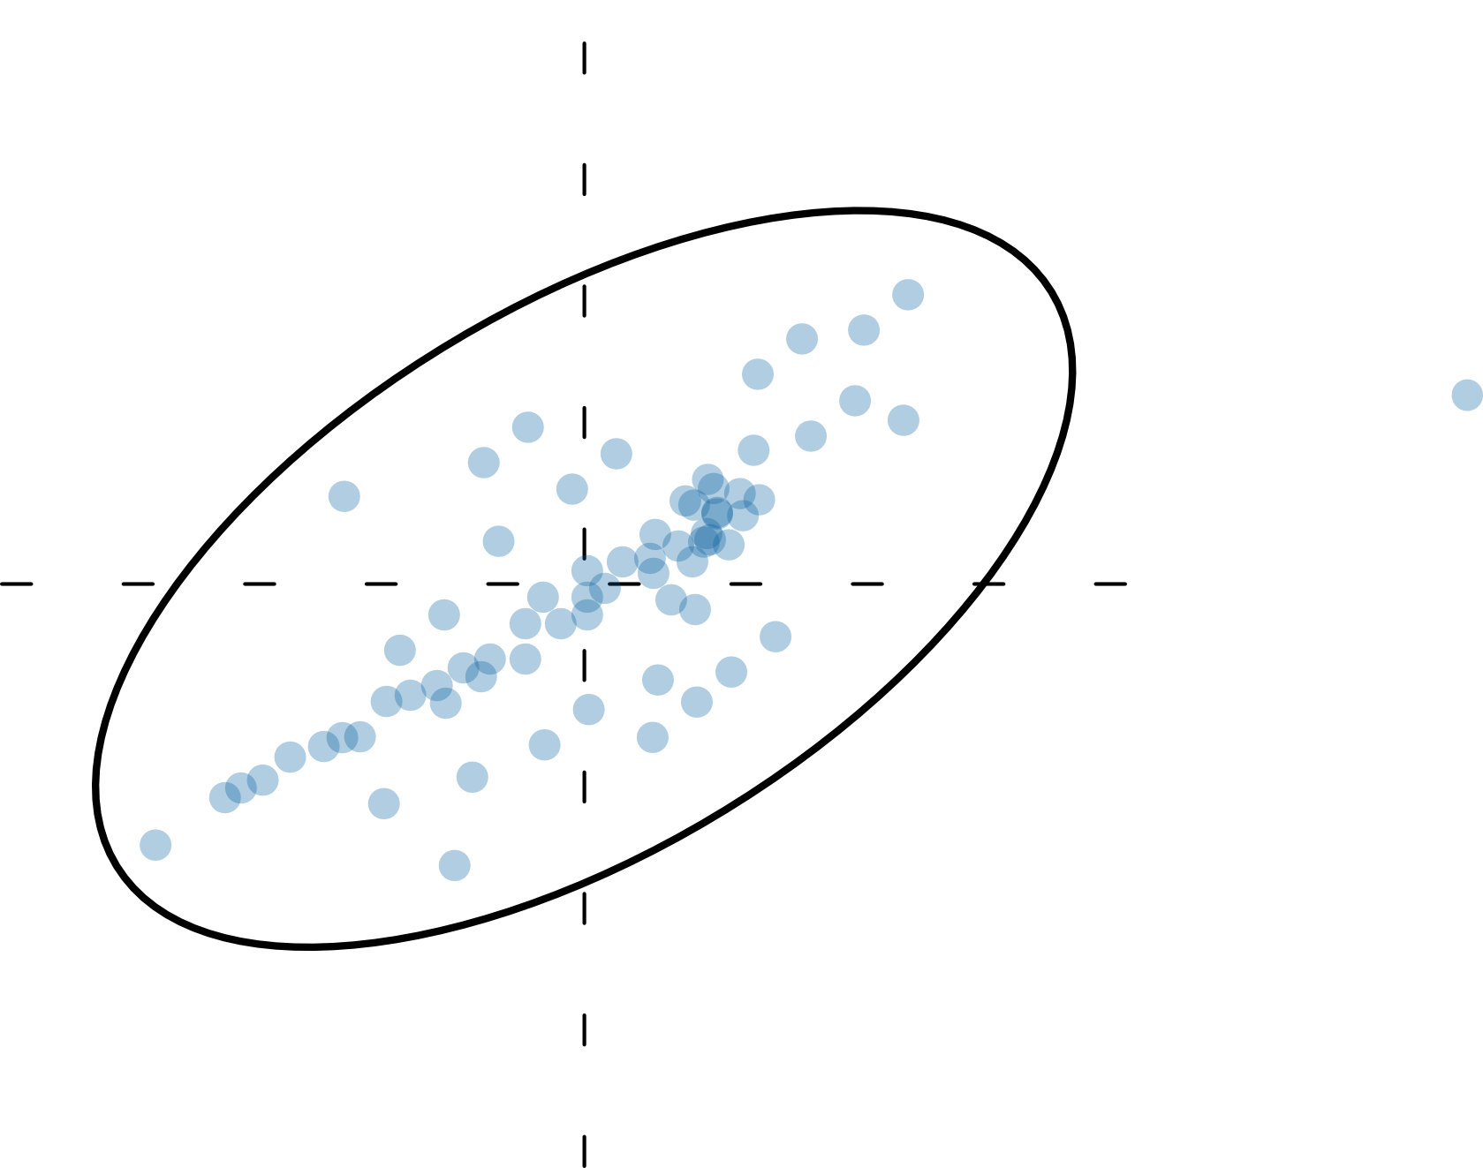
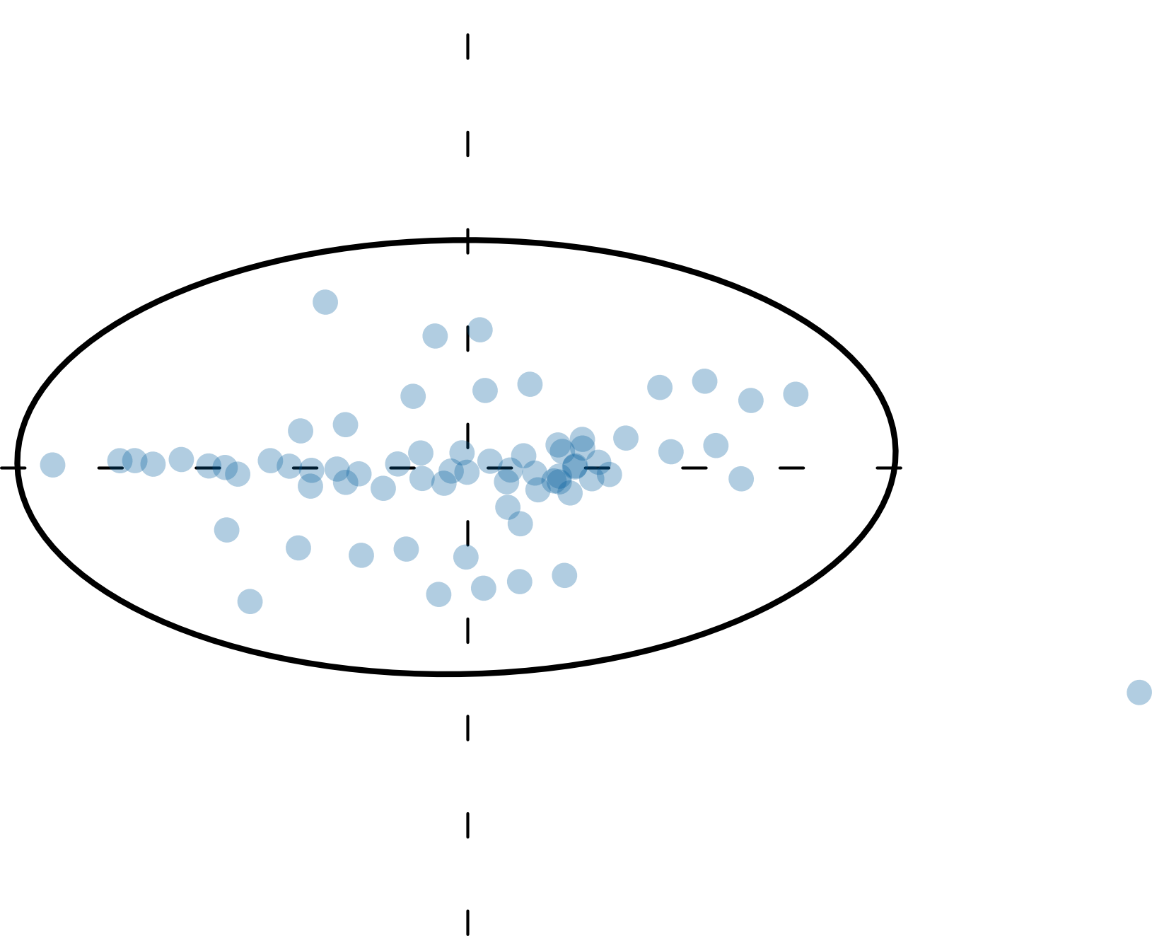
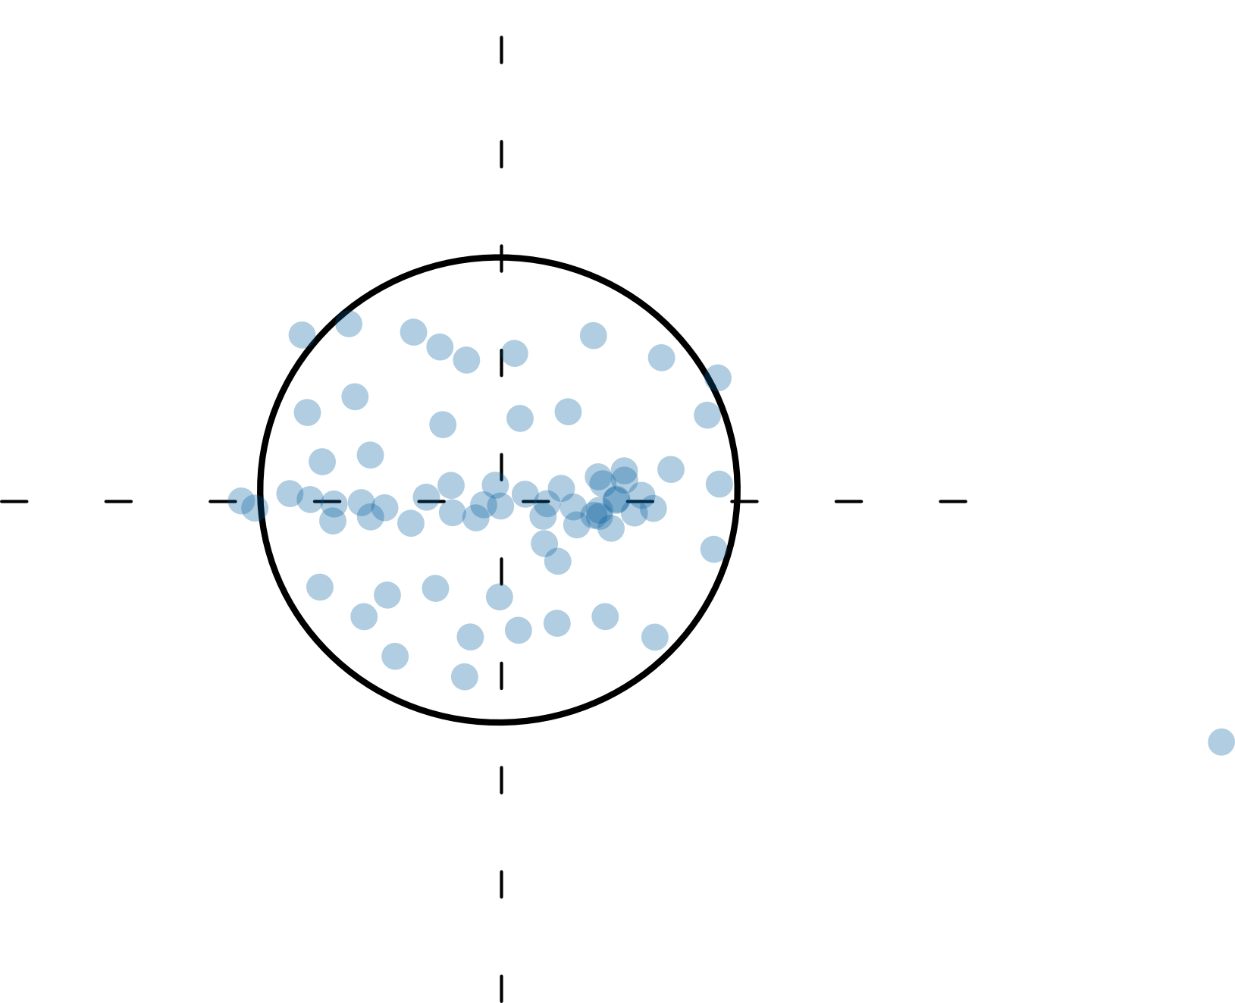
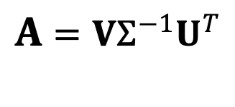
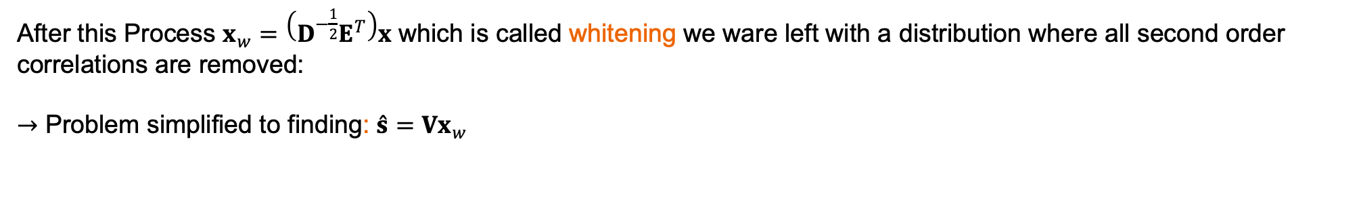

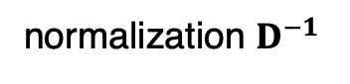

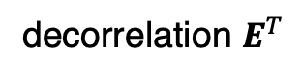
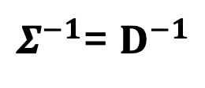
Independent Component Analysis Solving blind source seperation using ICA
If we can find each of the SVD components we can determine the unmixing matrix A
$A$ $=VΣ^{−1}U^{T}$
It can be shown that this can be formulated as an eigenvector problem, where:
$Σ^{−1}$= $D^{−1}$
$$\&$$
$$U^{T}=E^{T}$$
D, E are the singular values and eigenvectors composed from the covariance matrix of X
decorrelation $E^{T}$
normalization $D^{−1}$
After this Process $x_{w}=\left(D^{−\frac{1}{2}}E^{T}\right)x$ which is called whitening we ware left with a distribution where all second order correlations are removed:
$→$ Problem simplified to finding: $\overset{ˆ}{s}=Vx_{w}$
need to exploit the statistics of independence to identify V.
Notes:
The goal if ICA is to solve BSS problems which arise from a linear mixture

Slide 12
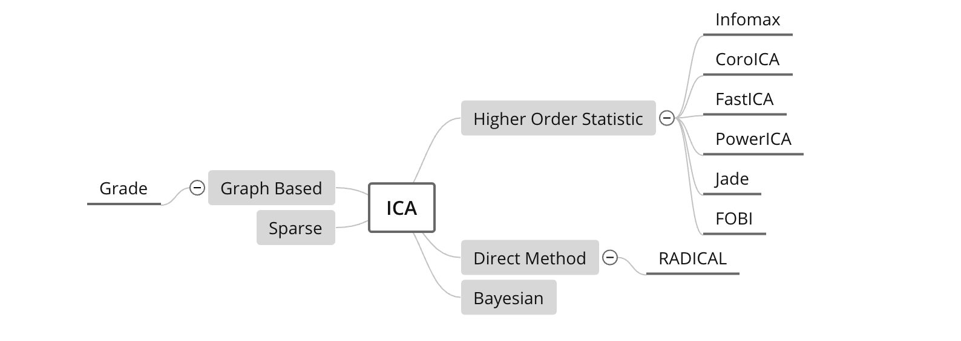
Independent Component Analysis A generic Algorithm description
Quick Summary of the Algorithm:
1. Subtract off the mean of the data in each dimension.
2. Whiten the data by calculating the eigenvectors of the co-variance of the data.
3. Identify final rotation matrix that optimizes statistical independence.
What is left to compute:
Rotate the data such that either
(a) the output signal components are as statistically independent as possible
(b) the output signal components are most non-Gaussian.
ICA Algorithms – a broad overview:

Slide 13
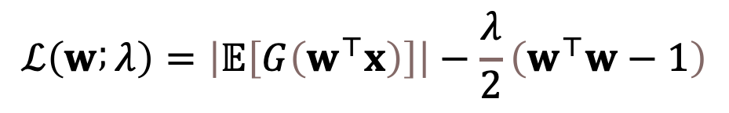
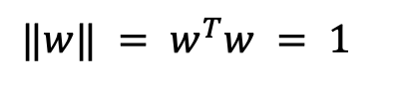
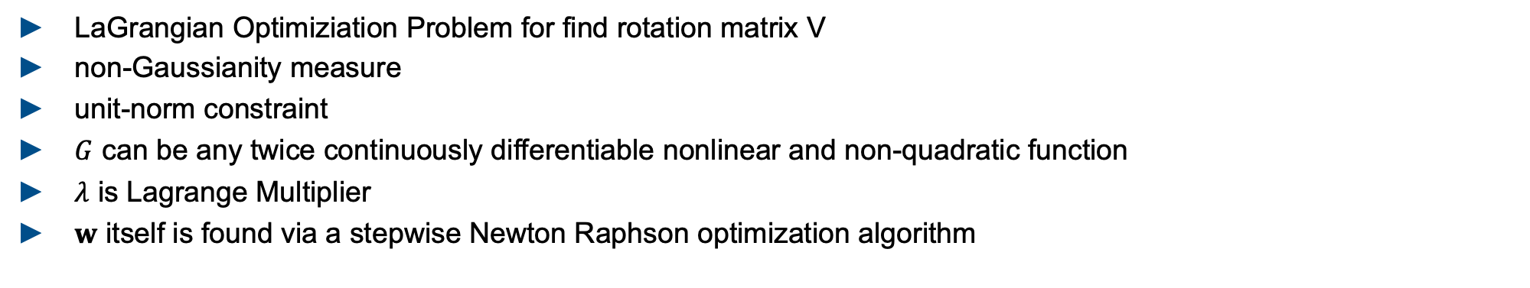
Independent Component Analysis Example Concept PowerICA
$$ℒ\left(w ; λ\right)=\left|𝔼\left[G\left(w^{⊤}x\right)\right]\right|−\frac{λ}{2}\left(w^{⊤}w−1\right)$$
local maxima
$$‖w‖ = w^{T}w = 1$$
LaGrangian Optimiziation Problem for find rotation matrix V
non-Gaussianity measure
unit-norm constraint
$G$ can be any twice continuously differentiable nonlinear and non-quadratic function
$λ$ is Lagrange Multiplier
$w$ itself is found via a stepwise Newton Raphson optimization algorithm

Slide 14
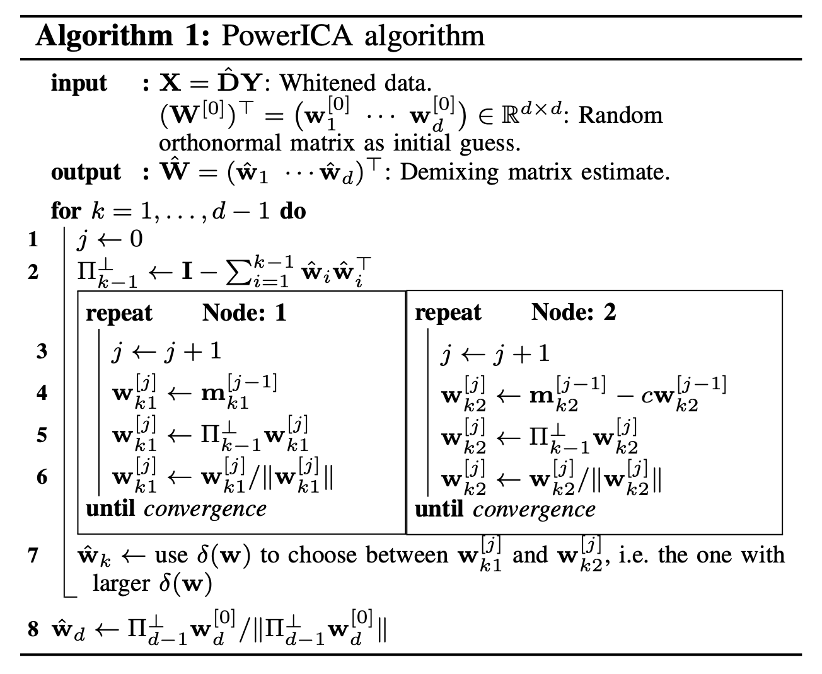
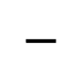
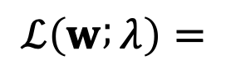
Independent Component Analysis Example Algorithm PowerICA – alternative approach up for discussion
$$ℒ\left(w ; λ\right)=$$
non-Gaussianity measure
$$−$$
unit-norm constraint
Verbalize this!

Slide 15
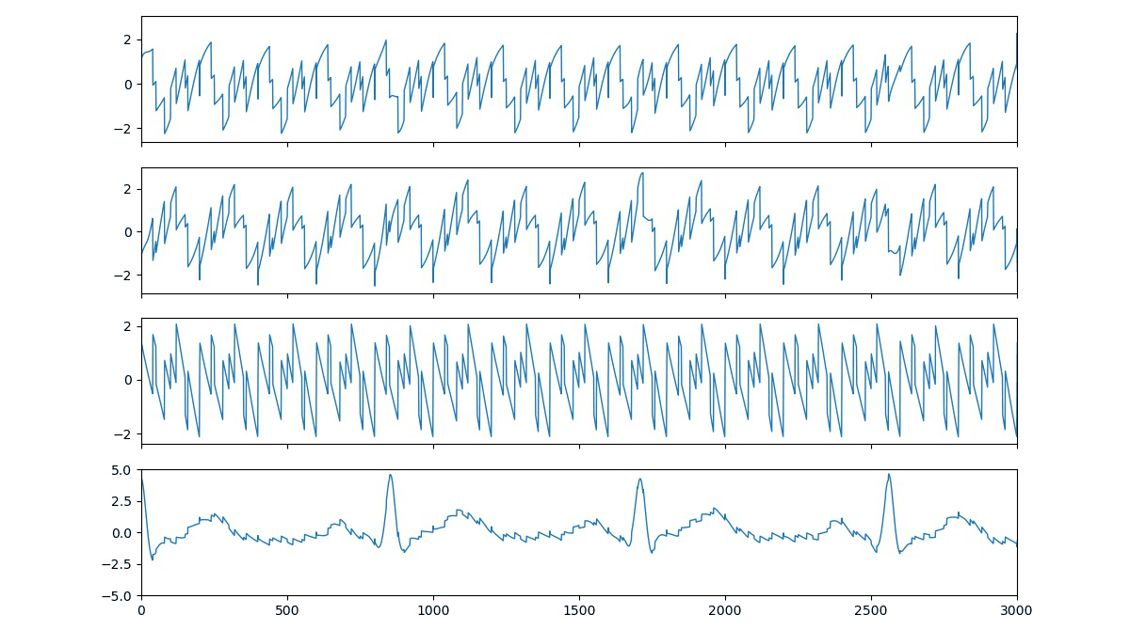
ICA Signal Reconstruction From Mixed Example Signals to Deconstructed Signals
Sin
Saw
Rectangle
ECG

Slide 16
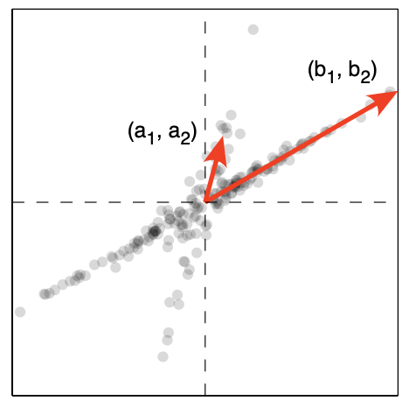
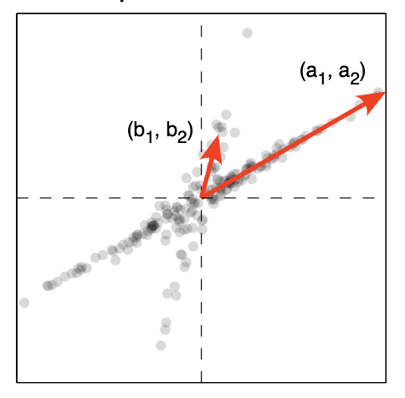
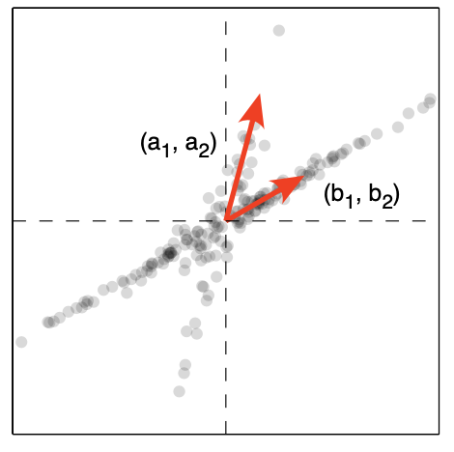
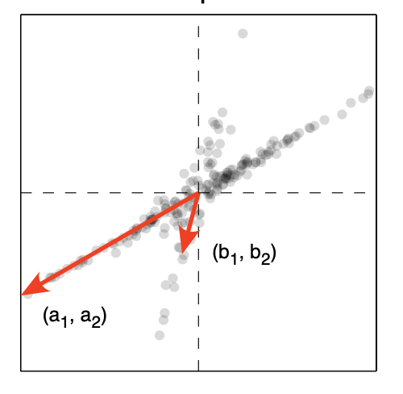
Independent Component Analysis Notes on peculiarities of ICA
Original Signals
Permutation
Reconstructred signal Signals
Due to ambiguities of the method the extracting of the unobserved independent source signals is only accurate up to:
𝑑 × 𝑑 permutation matrix $P$, scaling matrix $D$ and sign-change matrix $L$
Permutation
Scaling
Sign Change
Notes:
P = (obtained by permuting the rows of 𝑑 × 𝑑 identity matrix),
D = (a diagonal matrix with positive diagonal elements)

Slide 17
Agenda
1. Understanding the Basis of Source Separation via an Intuitive Example-Driven
Approach
2. Discussion of Experiment Design
3. Graph Blind Source Separation
4. Graph Blind Source Separation results
Summary of major outcomes
Problems and future research

Slide 18
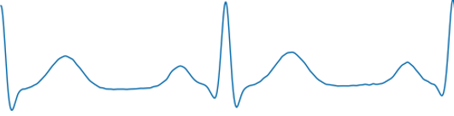
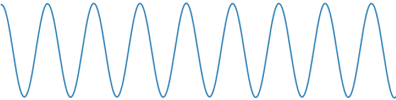
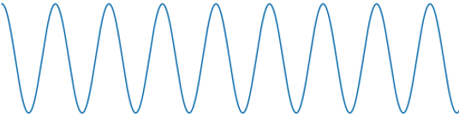
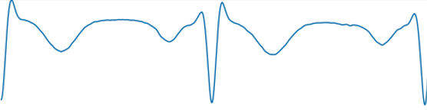
Experiment Design Goal
Goals of this project:
Evaluate ICA -Algorithms in terms of robustness
Elaborating new approaches to increase robustness against noise and outliers in EEG-measurements
How can we evaluate the ICA-Algorithms?
The ICA-Algorithms return the reconstructed Signal $\hat{X }$and an estimated Mixing Matrix $\hat{A}$
2 options: compare Input and Reconstructed Signals or Compare Mixing Matrix A with its estimate $\hat{A}$
$$vs.$$
$$\left(\begin{matrix}0.23 & 0.75 \\ 0.55 & 0.91\end{matrix}\right)$$
$$vs.$$
$$\left(\begin{matrix}0.23 & 0.55 \\ 0.75 & 0.91\end{matrix}\right)$$
$$X$$
$$\hat{X }$$
$$A$$
$\hat{A}$
Problems:
The solution of ICA is not unique: $\hat{A}$ and $\hat{X }$ can pertubed, scaled or have sign changes
Find Metrics which deal with that

Slide 19
Experiment Design Metrics: MD, MSE
Minimum Distance Index (based on MM):
Key idea: The inverse of the Mixing Matrix equals the Unmixing Matrix, so the multiplication is the identity matrix $A=W^{−1} \underset{→}{\text{yields}} AW=I$
Therefore: if $\hat{A}W=I\overset{⇒}{}$ The Algorithm performed well
Where $C=PJD$ considers Permutation P, Scaling D and sign changes J, p = number of signals
$inf_{C}{ }$= Minimize Frobenius Norm
0 indicates a good performance, 1 indicates a bad one
$$MD=\frac{1}{\sqrt{(p−1)}}⋅inf_{c}{{\left\|C\hat{A}W −I \right\|}_{2}}$$
Mean squared Error (MSE):
Taking the Mean of the squared residuals
4 values take mean or median
Problem:
Required groundtruth data for X and A
residuals

Slide 20
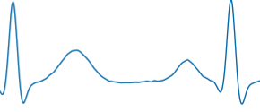
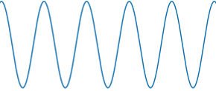
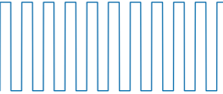

Experiment Design General approach
What do we have to do:
Generate ideal Input Signals $X∈ ℝ^{4x10000}$ and a random ideal Mixing Matrix. $A ∈ ℝ^{4x4}$ groundtruth
Standard Signals:
ECG Signal: 2Hz
Sinus: 5Hz
Rectangle: 10Hz
Sawtooth: 25Hz
fs: 1000Hz
Normalized to [-1,1]
$$\left(\begin{matrix}0.11 & 0.34 & 0.77 & 0.24 \\ 0.41 & 0.91 & 0.63 & 0.49 \\ 0.99 & 0.56 & 0.23 & 0.33 \\ 0.38 & 0.45 & 0.03 & 0.23\end{matrix}\right)$$
Brainwaves:
$δ−Waves:0.5−3Hz$
$θ−Waves:3−8Hz$
$α−Waves:8−12Hz$
$β−Waves:12−38Hz$
2. Run different Algorithms for different cases:
different Sample Sizes,
different levels of contamination (noise, outlier)
3. Evaluate $\hat{X },\hat{A}$on MD, MSE, SNR
4. Do this multiple times (reproducability)
Monte Carlo Study (random Input, deterministic output)
5. Statistical Analyses on multiple outcomes
interpret results

Slide 21
Experiment Design Monte Carlo Flow Chart
Input Signals
Standard Input Signals
ECG, Sinus, Rectangle, Sawtooth
Runs = 1000
2. Mix Signals with Mixing Matrix A (random)
$A ∈ ℝ^{4x4}$
Mix Signals
Contaminate Signals
3. Contaminate Signals
Add single or patchy Outlier (1000std) and/or white noise (3std)
Whitening
4. Whitening Process
Decorrelate Signals: meaning that the covariance matrix is diagonal and that all the diagonal elements are equal.
ICA
5. Perform ICA
4 Algos: JADE, RADICAL, CoroICA, PowerICA
$$\hat{X}$$
$$Â$$
Evaluate on Metrics
6. Evaluate Single Run
Minimum Distance, MSE
7. Evaluate ICA
Get 1000 MDs and MSEs.
Empirical Data Analyses
BoxPlot

Slide 22
Experiment Design Expirement Types
1.) Focus on Sample Size
Initialize standard signals with different Sample Sizes: 1000, 2500, 5000, 10000, 15000
Type I: No Noise, No Outlier, 1000 runs
Type II: 40dB SNR, No Outlier, 1000 runs
Type III: No Noise, 0.1% Outlier with std = 100, 1000 runs
Type IV: 40dB SNR, 0.1% Outlier with std = 100, 1000 runs
2.) Focus on amount of noise/outlier
Initialize standard signals with fix Sample Size of 10000
Type V: increase noise SNR: 40 dB, 30 dB, 20 dB, 10 dB, 6 dB, 3 dB
Type VI: increase Outlier patchy %: 0.1, 0.25, 0.5, 1, 1.5, 5, 10, 20, 50 with 1000 STD
Type VII: increase Outlier impulsive %: 0.1, 0.25, 0.5, 1, 1.5, 5, 10, 20, 50 with 1000 STD
Type VIII: increase Outlier amount = 1, with 3, 10, 50, 100, 1000 STD

Slide 23







Results Type 1 - 4
MD = 0.2
MD = 0.4
MD = 0.6

Slide 24

Results Type 1 - 4
Sample Size 10000
Type 1 (ideal) | Median MD | Median MSE | Median SNR [dB]
PowerICA | $$0.21±0.001$$ | $$0.0039±0.0002$$ | $$24.16±0.21$$
Jade | $$0.21±0.03$$
CoroICA | $$0.06±0$$ | $$0.0009±0$$ | $$35.1±4$$
Radical

Slide 25

Results Type 1 - 4
Power ICA
PowerICA | Median MD | Median MSE | Median SNR [dB]
Type 1 (ideal) | $$0.21±0.001$$ | $$0.0039±0.0002$$ | $$24.16±0.21$$
Type 2 (noise) | $$0.18±0.006$$ | $0.0034$ $$± 0.0004$$ | $$25.93±0.63$$
Type 3 (outlier) | $$0.81±0.06$$ | $$0.36±0.1$$ | $$5.3±1.8$$
Type 4 (noise + outlier) | $$0.81±0.06$$ | $$0.35±0.1$$ | $$5.47±1.78$$
Next Step:
How much noise does it take to cause a breakdown ?
Sample Size of min. n = 5000 is neccessary
Even 0.1% Outlier causes failure for every algorithm
For 40dB SNR -> variance increses slightly, more outliers

Slide 26

Results Type 5 - 7
Power ICA
Type 6-7:
Complete breakdown even for 1 outlier
Type 5:
Noise <20dB SNR breakdown
Did our Robustness Plugins improve the results ?
Robust Covariance Estimation in Whitening:
Causes breakdown
Robust objective Function in higher Order statistics:
JADE: Causes breakdown
Conclusion:
Preprocessing of the data essential! -> Outlier removal + Smoothing
We need new approaches to improve the performance

Slide 27

EEG case study Semi Synthetic EEG data as Input Signals
Semi Synthetic electroencephalogram - EEG data
1. Use real EEG data as Inputs
Insert Plot here
2. Mix Data with random Mixing Matrix
Eye Blink
3. Add 1 realistic artifact, on mixed data
Optional: Add single or patchy Outliers and white noise (3std)
Artifacts which typically come along with EEG data
Muscle
Electrical
Electrical

Slide 28
EEG case study Results with Semi Synthetic EEG data
Able to reconstruct the EEG signals and Artifacts
Insert Plot here

Slide 29
TODO
Delorme one slide -> near eeg, closer to reality
2. cases -> classical rosbustness
-> eeg like artifacts
Good and bad recon
Possible Reasons:
Distributions don‘t follow the expected model
Important values are weighted down by new objective functions
Signal to Noise Ratio (SNR):
Considered here as the variance of the resiudal
Transformed in dB
4 values take mean or median
Matrix fett schreiben
Eventuelle andere Signale zeigen auf slide 1
4 Signale ersetzen
Drop bei 10000 erklären -> auf drawbacks von MD hinweisen.
Evtl auch nur bis 5000 zeigen

Slide 30


Experiment Design Monte Carlo Flow Chart III
Input Signals
How do we measure the performance of the Algorithms ?
Runs = 1000
Mix Signals
1. Evaluation on Metrics:
$\hat{X}$ = recovered Signals, $Â$= estimated Mixing Matrix
Evaluate the performance each run
Based on Mixing Matrix: Minimum Distance: $MD(A,Â)$
Based on reconstructed Signals: Mean squared error: $MSE(X,$ $\hat{X}$), Signal to Noise Ratio: $SNR(X,$ $\hat{X}$)
Contaminate Signals
Whitening
ICA
vs.
$$\hat{X}$$
$$Â$$
Evaluate on Metrics
2. Empirical Data Analyses
Get 1000 (#runs) metrics
Calcualte: Mean, Standard Deviation, Median, nMAD of MD,MSE,SNR
BoxPlot
Empirical Data Analyses

Slide 31
Experiment Design Monte Carlo Flow Chart II
Input Signals
Runs = 1000
Whitening
Mix Signals
Plug in robustness
Perform Robust Covariance Estimation from Python Package RobustSP
Spatial Median
M-Estimator of Scatter Matrix (Huber)
Contaminate Signals
Whitening
ICA
Independent Component Analyses
Perform ICA by 4 different Algorithms: JADE, RADICAL, CoroICA, PowerICA
Plug in Robustness JADE: Replace Expected Value by robust objective function.
Huber, Tukey
Evaluate on Metrics
Empirical Data Analyses

Slide 32
Agenda
1. Understanding the Basis of Source Separation via an Intuitive Example-Driven
Approach
2. Discussion of Experiment Design
3. Graph Blind Source Separation
4. Graph Blind Source Separation results
Summary of major outcomes
Problems and future research

Slide 33






Shortcomings
Significant performance loss for sample sizes with N << 5000
Unable to recover more than one Gaussian signal
For SNR ≤ 20dB high variance in performance
Failures become increasingly likely
Inherently unrobust against outliers
A single outlier will lead to failure of the method
N
1. Samples
2. Gaussian
3. SNR ≤ 20dB
4. Outlier

Slide 34


Recent Developments
In 2010: Blind Source Separation(BSS) using graph theory
In 2020: First approaches to combine non-gaussianity based BSS with graph-based BSS (Jari Miettinen)
What is the idea?
Design a method that uses:
Non-Gaussianity measure (classic ICA)

Slide 35

Recent Developments
In 2010: Blind Source Separation(BSS) using graph theory
In 2020: First approaches to combine non-gaussianity based BSS with graph-based BSS (Jari Miettinen)
What is the idea?
Design a method that uses:
Non-Gaussianity measure (classic ICA)
Information about underlying graph structure
Combine those in a way that they complement each other

Slide 36



Graph Blind Source Separation
What are Graphs?

Slide 37
Graph Blind Source Separation What are Graphs?
Graphs are structures build by vertices that are connected by edges
Edges represent proximity between two vertices
Graph structure can be stored in a matrix ⇒ The adjacency matrix A
Examples: Social networks, sensor networks, brain networks, etc.
0 1 1 1 1 1 1
7
2
1 0 0 0 0 0 0
1 0 0 0 0 0 0
A =
1 0 0 0 0 0 0
6
1
3
1 0 0 0 0 0 0
1 0 0 0 0 0 0
4
1 0 0 0 0 0 0
5
Undirected unweighted graph

Slide 38
Graph Blind Source Separation What are Graphs?
Graphs are structures build by vertices that are connected by edges
Edges represent proximity between two vertices
Graph structure can be stored in a matrix ⇒ The adjacency matrix A
Examples: Social networks, sensor networks, brain networks, etc.
0 1 1 1 1 1 1
7
2
1 0 0 0 0 0 0
1 0 0 0 0 0 0
A =
1 0 0 0 0 0 0
6
1
3
1 0 0 0 0 0 0
1 0 0 0 0 0 0
4
1 0 0 0 0 0 0
5
Undirected unweighted graph

Slide 39
Graph Blind Source Separation What are Graph Signals?
Analogy to discrete time signals
Simplest case: Recursive Line Graph
Each node represents a sample point
Directed graph ⇒ unsymmetric adjacency
0
1
2
3
…
N
n ∈ ℕ, n ≤ N
0 1 0 0 0 0 … 0
0 0 1 0 0 0 … 0
0 0 0 1 0 0 … 0
A =
0 0 0 0 1 0 … 0
. . . . . . … 0
. . . . . . … 1
1 0 0 0 0 0 … 0

Slide 40
Graph Blind Source Separation What are Graph Signals?
Analogy to discrete time signals
Simplest case: Recursive Line Graph
Multiple Signals can share the same graph
In this case: The class of all periodic signals with period N
0
1
2
3
…
N
n ∈ ℕ, n ≤ N
0 1 0 0 0 0 … 0
0 0 1 0 0 0 … 0
0 0 0 1 0 0 … 0
A =
0 0 0 0 1 0 … 0
. . . . . . … 0
. . . . . . … 1
1 0 0 0 0 0 … 0

Slide 41

Graph Blind Source Separation What are Graph Signals?
Analogy to discrete time signals
Simplest case: Recursive Line Graph
We call ${XA}^{k}=X^{(k)}$ a graph-shift by k
For Line Graph ⇔ Shift operator as known from Digital Signal Processing
When a graph-shift is applied, the signal will shift along every connected path made up of the k nearest edges.
k = 1 shift
0
1
2
3
…
N
n ∈ ℕ, n ≤ N

Slide 42



Graph Blind Source Separation Graph-Autocorrelation
Using the introduced graph-shift we define the graph-autocorrelation matrix analog to the sample autocorrelation:
$C_{X}^{Sample}≔\frac{1}{N−1}$ $XX^{T}$
$C_{X}^{Graph}\left(k\right)≔\frac{1}{N−1}X^{(k)}X^{T}=\frac{1}{N−1}XA^{k}X^{T}$
$C_{X}^{Sample} ∈{\text{ℝ}}^{N ×N}:$ N dimensional square matrix of sample autocorrelation
$C_{X}^{Graph}\left(k\right) ∈{\text{ℝ}}^{N ×N}:$ N dimensional square matrix of graph-autocorrelation for k graph-shifts
$A^{k}∈{\text{ℝ}}^{N ×N}:$ k-th power of Adjacency matrix corresponding to k shifts along the graph
$X=(X_{1}, X_{2},…X_{D})∈{\text{ℝ}}^{N × D}:$ D signals stored as column vectors
The k-shift along paths of an underlying graph can provide additional information about independence between signals!
$=\frac{1}{N−1}$ $XIX^{T}$
$A^{k}{\left.​\right|}_{k=0}=I$ ,
$I$ $∈{\text{ℝ}}^{N ×N}$: Identity Matrix

Slide 43






Graph Blind Source Seperation Graph Decorrelation
Find a matrix $U$ that diagonalizes $UC_{X}^{Graph}U^{T}$ as much as possible
The solution for $U$ decorrelates the signals $X$ in the graph-sense
$U$ is a solution of the BSS problem for graph-signals
Advantages | Disadvantages
Independent of data distribution | Graph structure not directly available
Works well with small sample sizes | Highly dependent on accurate graph
Graph structure in many real- world problems
N

Slide 44
Graph Blind Source Seperation Graph Decorrelation
PowerICA shortcomings:
Significant performance loss for sample sizes with N << 5000
Unable to recover more than one gaussian signal
Advantages | Disadvantages
Independent of data distribution | Graph structure not directly available
Works well with small sample sizes | Highly dependent on accurate graph
Graph structure in many real- world problems
N
Graph based BSS and non-gaussianity based BSS seem to make up for each others weak points.

Slide 45






Graph Blind Source Separation Composite Objective
How can we combine them?
Approach from Jari Miettinen et al. (Aalto University)
Define composite objective function $f_{composite}$:
PowerICA objective:
Maximize estimate of negentropy as a measure of non-Gaussianity with the Lagrangian method.
$$\text{(1−}\text{λ}\text{)}$$
+
Composite objective function $f_{composite}$
Graph decorrelation objective:
Diagonalize graph-autocorrelation as much as possible. For only one adjacency ⇒ eigenvalue problem.
$$\text{λ}$$
Balance Parameter
$$\text{0 < }\text{λ}\text{ < 1}$$

Slide 46
Agenda
1. Understanding the Basis of Source Separation via an Intuitive Example-Driven
Approach
2. Discussion of Experiment Design
3. Graph Blind Source Separation
4. Graph Blind Source Separation results
Summary of major outcomes
Problems and future research

Slide 47



Graph BSS Results Clean data
Standard signals (Cos, Rect, ECG, Saw)
Clean data: Better results than standard PowerICA (1000 samples)

Slide 48

Graph BSS Results Clean data
Standard signals (Cos, Rect, ECG, Saw)
Clean data: Better results than standard PowerICA (1000 samples)
0,6
0,4
0,19
0,1
0,6
0,1

Slide 49


Graph BSS Results Noisy data
Comparable for noisy signals (up to 20dB SNR)

Slide 50

Graph BSS Results Noisy data
Comparable for noisy signals (up to 20dB SNR)
0,8
0,38
0,2
0,8
0,2

Slide 51


Graph BSS Results Outlier contamination
Breakdown point already with one large outlier (100std)

Slide 52

Graph BSS Results Outlier contamination
Breakdown point already with one large outlier (100std)
1,4
0,8
0,4
1,4
0,4

Slide 53


Graph BSS Results
Also possible for semi-synthetic EEG data
0
1
2
3
4
5
6
0
1
2
3
4
5
6
t[s]
t[s]

Slide 54


Graph BSS Results Semi-synthetic EEG data
Artifacts clearly extractable:

Slide 55
Graph BSS Results Semi-synthetic EEG data
Events clearly extractable:
Button push
Visual stimulus
0
1
2
3
t[s]
4
5
6

Slide 56
Agenda
1. Understanding the Basis of Source Separation via an Intuitive Example-Driven
Approach
2. Discussion of Experiment Design
3. Graph Blind Source Separation
4. Graph Blind Source Separation results
Summary of major outcomes
Problems and future research

Slide 57
Summary of major outcomes
Question 1: What is ICA?
Question 2: How to compare algorithms?
Question 3: Which algorithm performs best? What happens with noise or outlier?
Question 4: How to robustify algorithms?
Question 5: What is Graph Signal processing / Graph BSS?
Question 6: Outcomes of Graph Signal processing?

Slide 58

Summary of major outcomes Question 1: What is ICA?
Mathematical concept to extract (independent = non-gaussian) signals from mixed signals
Different approaches to obtain the demixing matrix → 4 algorithms
„ICA tries to decorrelate mixed up signals and find the optimal demixing matrix based on optimizing different measures of independence“
CoroICA

Slide 59

Summary of major outcomes Question 2: How to compare algorithms?
Minimum distance, MSE and SNR
Correlation of different metrics important
„One Metric sometimes provides not
the whole information: We need to find
how different metrics correlate“
0,8
0,6
0,4
Median of MSEs
0,2
0,0
0,0
0,2
0,4
0,6
0,8
1,0
Minimum Distance
0,6
0,8
0,6
0,4
0,4
Mean of MSEs
0,19
0,2
0,0
0,1
0,0
0,2
0,4
0,6
0,8
1,0
Minimum Distance

Slide 60
Summary of major outcomes Question 3: Which algorithm performs best? What happens with noise or outlier?
Monte Carlo run with 10.000 runs: Evaluate metrics
More or less similar with good data (simulated (stationary) and real EEG data with added artifacts (non-stationary))
PowerICA: quite good with reasonable SNR (~20dB), fast and with low variance
Low sample sizes are problematic (<5000 samples)
Higher noise than 20dB SNR: smoothly becoming worse
All reach breakdown point with one large outlier
„All four algorithms: Good performance on well behaving data but higher noise level or larger outlier cause
failure ➔ No real robust algorithm“

Slide 61
Summary of major outcomes Question 4: How to robustify?
Whitening process crucial for algorithms
Different objective functions for some algorithms
Initialization quite important (local maxima/minima)
Within algorithms: quite complicated → model based
What we tried:
Plug-in robustness of covariance estimation in whitening process
Trying out different robust objective functions
Initialize PowerICA with Radical as a global optimizer
„No real improvement: sometimes with noise a bit better, but still low
breakdown point”

Slide 62
Summary of major outcomes Question 5: What is Graph Signal processing / Graph BSS?
Graph signal processing: Use proximity/similarity between components of the underlying signal
„Graph BSS tries to combine the ICA approach to maximize the measure of independence and the graph signal approach to decorrelate the nodes of the graph”
0
1
2
3
…
N

Slide 63
Summary of major outcomes Question 6: Outcomes of Graph BSS?
Monte Carlo with 1000 runs:
Better Blind Source Separation with good signals (low sample size)
Real EEG data with artifacts separable
Similar with noisy data
Breakdown point with one outlier as well
Problem with graph structure
„Graph BSS is good for low sample sizes and if the graph structure is available. Otherwise similar outcomes as standard BSS”

Slide 64
Agenda
1. Understanding the Basis of Source Separation via an Intuitive Example-Driven
Approach
2. Discussion of Experiment Design
3. Graph Blind Source Separation
4. Graph Blind Source Separation results
Summary of major outcomes
Problems and future research

Slide 65
Problems and future research
Problems:
Low Breakdown point
High noise dependency
Sample size important for standard ICA
Graph structure estimation: How to find correlation of graph signals?
Covariance estimation in higher dimensions problematic
Time consumption for real time EEG analysis
Future research:
Robust whitening / preprocessing
Incorporate noise process and outlier in model for ICA algorithm
Find good graph structure estimation
Robust covariance estimation in high dimensions

Slide 66

Thank you for your attention!

